Slide 1
Pemrograman Web
DOM (Document Object Model)

Slide 2
Dom (Document Object Model)
The DOM is a W3C (World Wide Web Consortium) standard.
"The W3C Document Object Model (DOM) is a platform and language-neutral interface that allows programs and scripts to dynamically access and update the content, structure, and style of a document."
Browser membuat DOM ketika halaman di load
Javasscript bisa mengakses dan memanipulasi element dalam html

Slide 3
Manfaat DOM
JavaScript can change all the HTML elements in the page
JavaScript can change all the HTML attributes in the page
JavaScript can change all the CSS styles in the page
JavaScript can remove existing HTML elements and attributes
JavaScript can add new HTML elements and attributes
JavaScript can react to all existing HTML events in the page
JavaScript can create new HTML events in the page

Slide 4
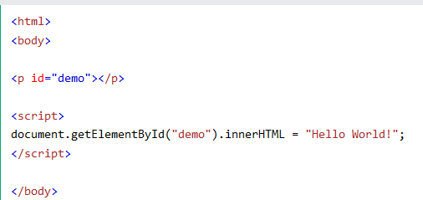
Contoh pengunaan dom
Latihan21.html

Slide 5
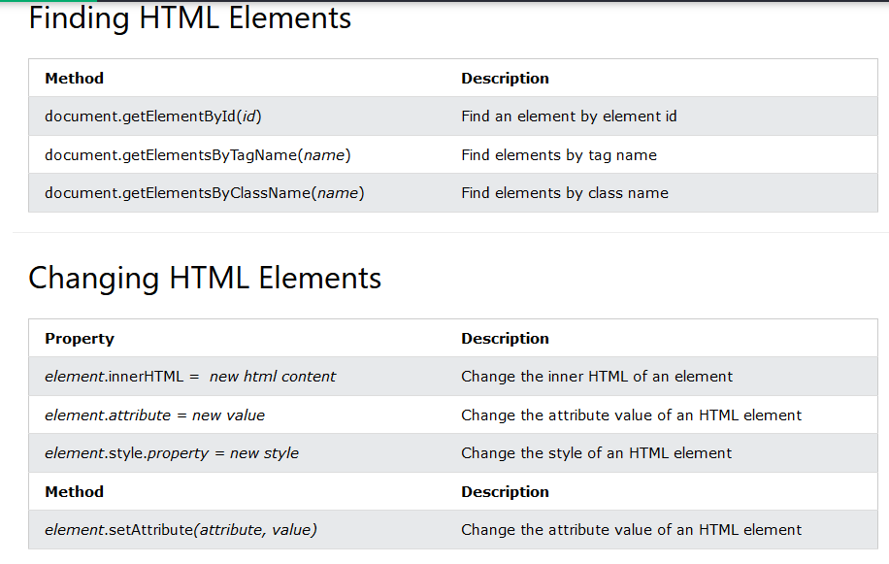

Slide 6
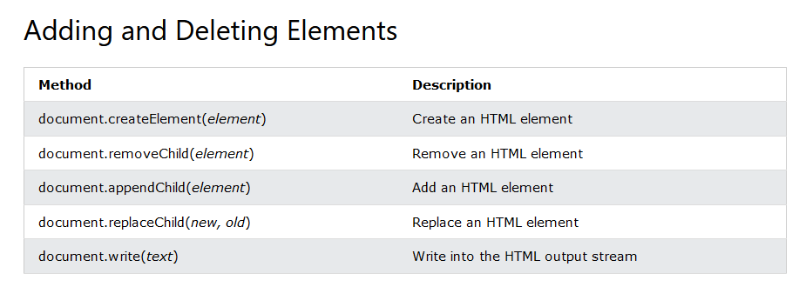
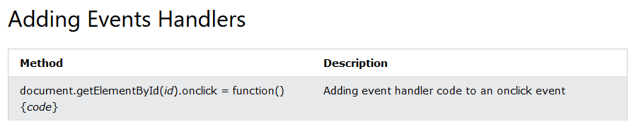

Slide 7
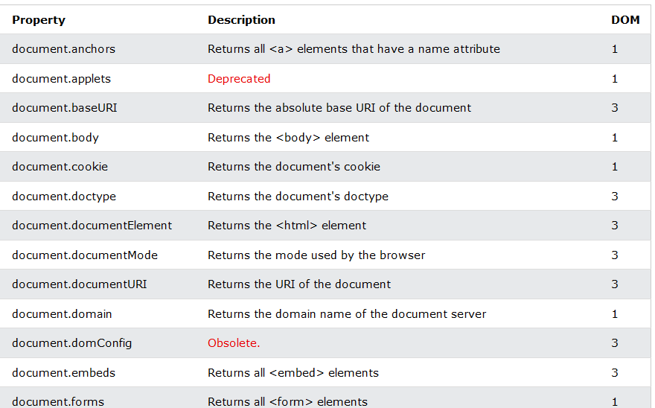

Slide 8
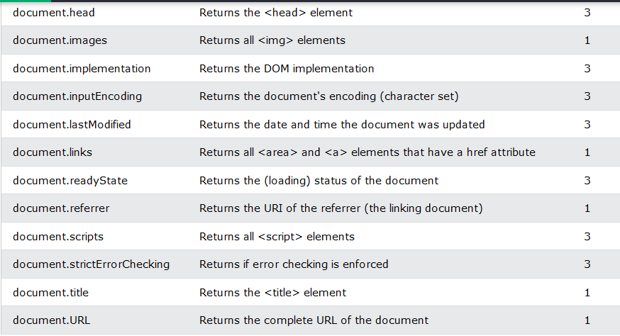

Slide 9
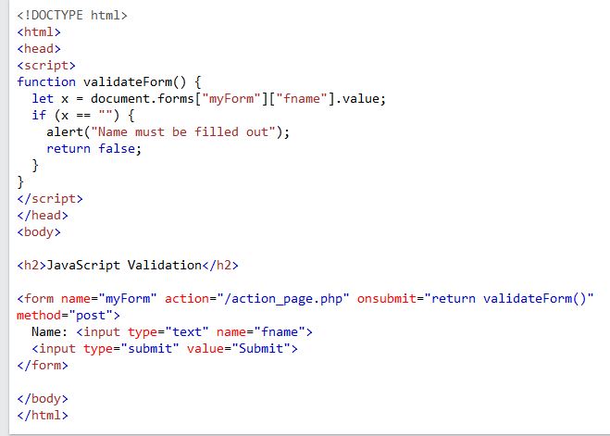
Latihan22.html

Slide 10
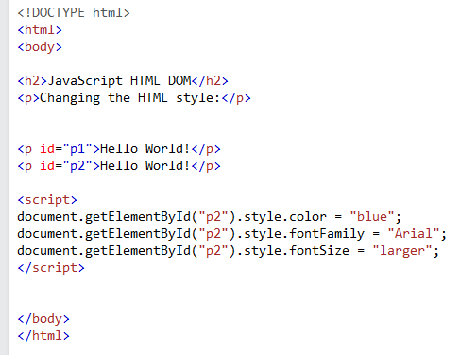
Latihan 23.html

Slide 11
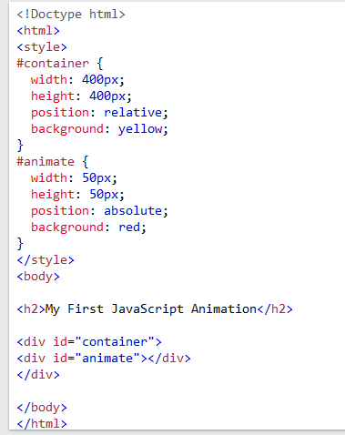
Latihan 24.html

Slide 12
Web Programming
Javascript Framework

Slide 13
Contoh framework javascript
Jquery
React
Angular
Vue.js

Slide 14
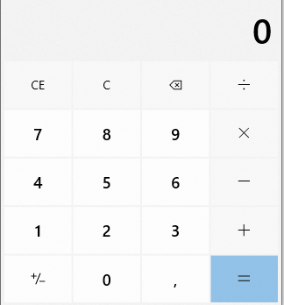
tugas
Buatlah program kalkulator seperti gambar disamping
Gunakan jQuery untuk memproses perhitungan
Gunakan bootstrap sebagai css framework

